Slide 1
RAVeN is the budding idea which took place in our mind when we came through different problems in our daily life. Every person has faced vehicle breakdown problems . With ever increasing no. of vehicles and their problems we thought why not provide a interface for the mechanic and user to unite all those with same common motive .

Slide 2
The idea is basically based on the simple theory of need and service. There is a common thinking if your vehicle breakdown you have to tow away or drag your vehicle to workshop or mechanic shop for repair. But what if you are struck on roads and there the problem comes into the picture. You have to either wait for help from other o locate yourself a nearby mechanic . Since this is a complete nuisance and if there as to a interface that can locate assistance for you nearby. That’s RAVeN.

Slide 3
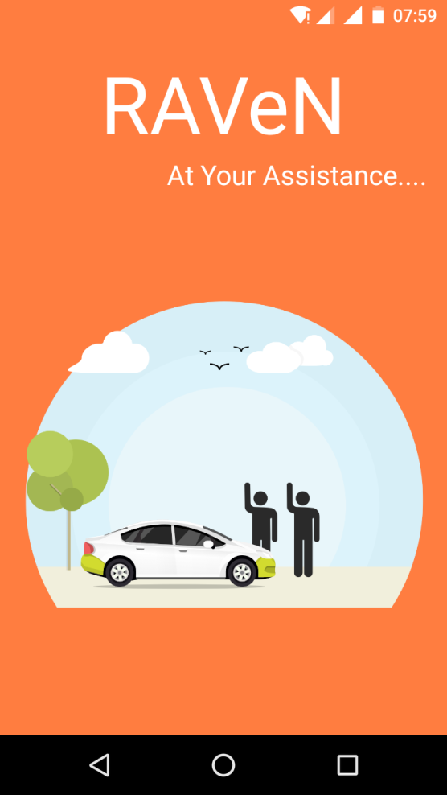
RAVeN :The App
RAVeN is a simple android based application. With the presence of large amount of users of android it makes android a suitable choice for developing this app.
RAVeN is a simple user friendly app as it takes the problems and just

Slide 4
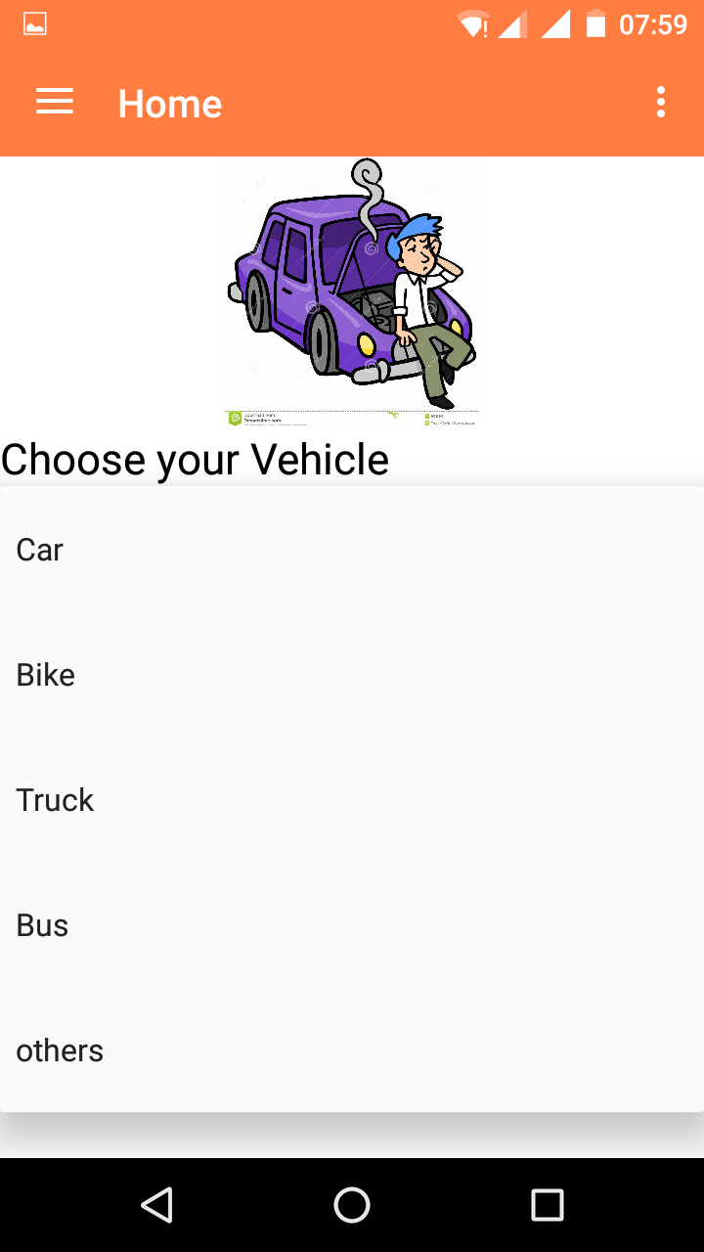
RAVeN takes problems from users

Slide 5
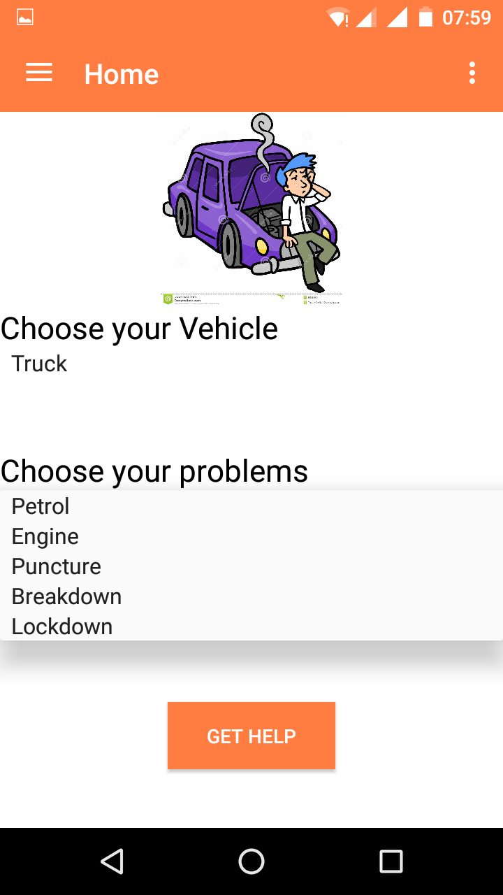
After choosing vehicle he can choose his problem

Slide 6


